Slide 1
Impact of aviation on Cirrus Cloud Formation within European airspace - Update III
Timothy van der Duim
Student Climate Physics

Slide 2
Cirrus data project
Data retrieval
Air traffic data unchanged (EUROCONTROL OpenSky)
Cirrus data 2015-2020 from CALIPSO LIDAR L2 data -> most accurate (active sensor)
High temporal resolution cirrus data 2015-2017 from SEVIRI Meteosat CLAAS Ed2.1 product
Optionally 2BCLDCLASS-LIDAR product from Cloudsat/CALIPSO could be used to validate (2015-2017)
Relative humidity & temperature from ERA5 Reanalysis

Slide 3
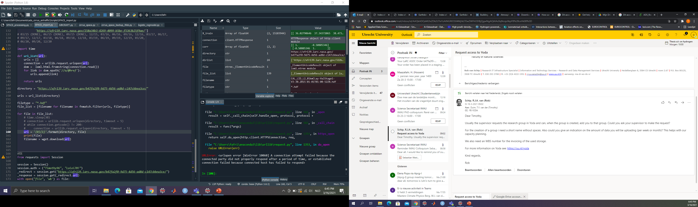
Cirrus data project
Code/data storage & sharing
GitHub repository
For data storage/sharing YODA?

Slide 4
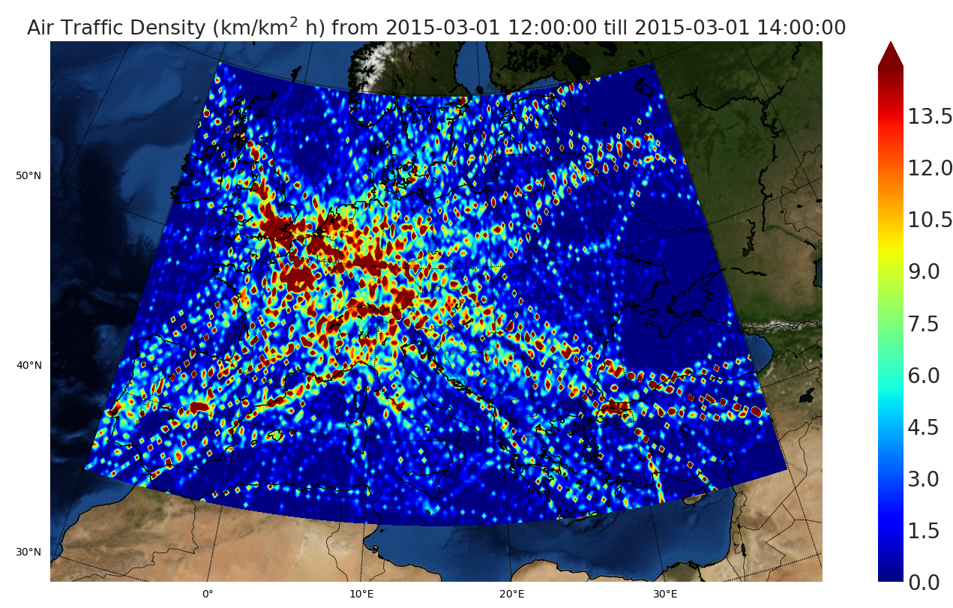
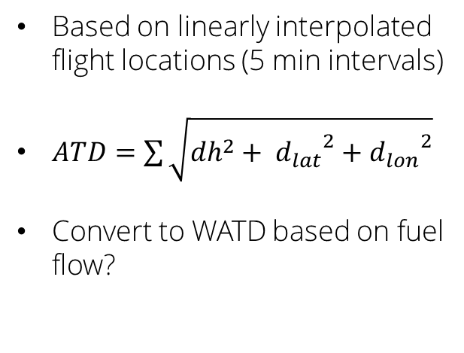
Cirrus data project
Air Traffic Density
Based on linearly interpolated flight locations (5 min intervals)
$ATD=\sum{\sqrt{{dh}^{2}+ {d_{lat}}^{2}+{d_{lon}}^{2}}}$
Convert to WATD based on fuel flow?

Slide 5
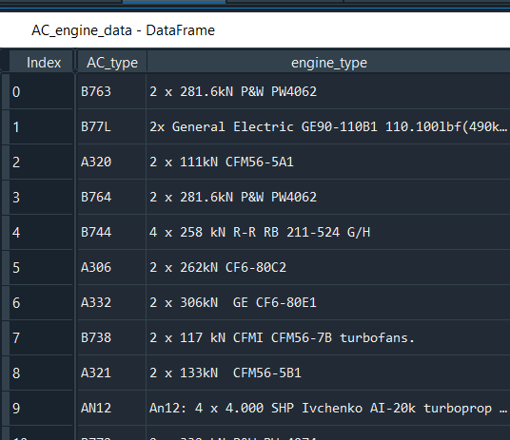
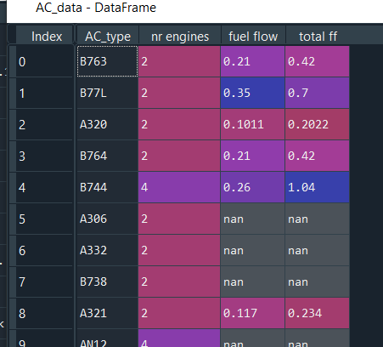
Cirrus data project
Weighted Air
Traffic Density
A/C type -> Engine type data scraped from EUROCONTROL website
Use of NLP to obtain 1) nr of engines and 2) engine model
Engine model -> fuel flow using ICAO Aircraft Emissions Databank from EASA

Slide 6
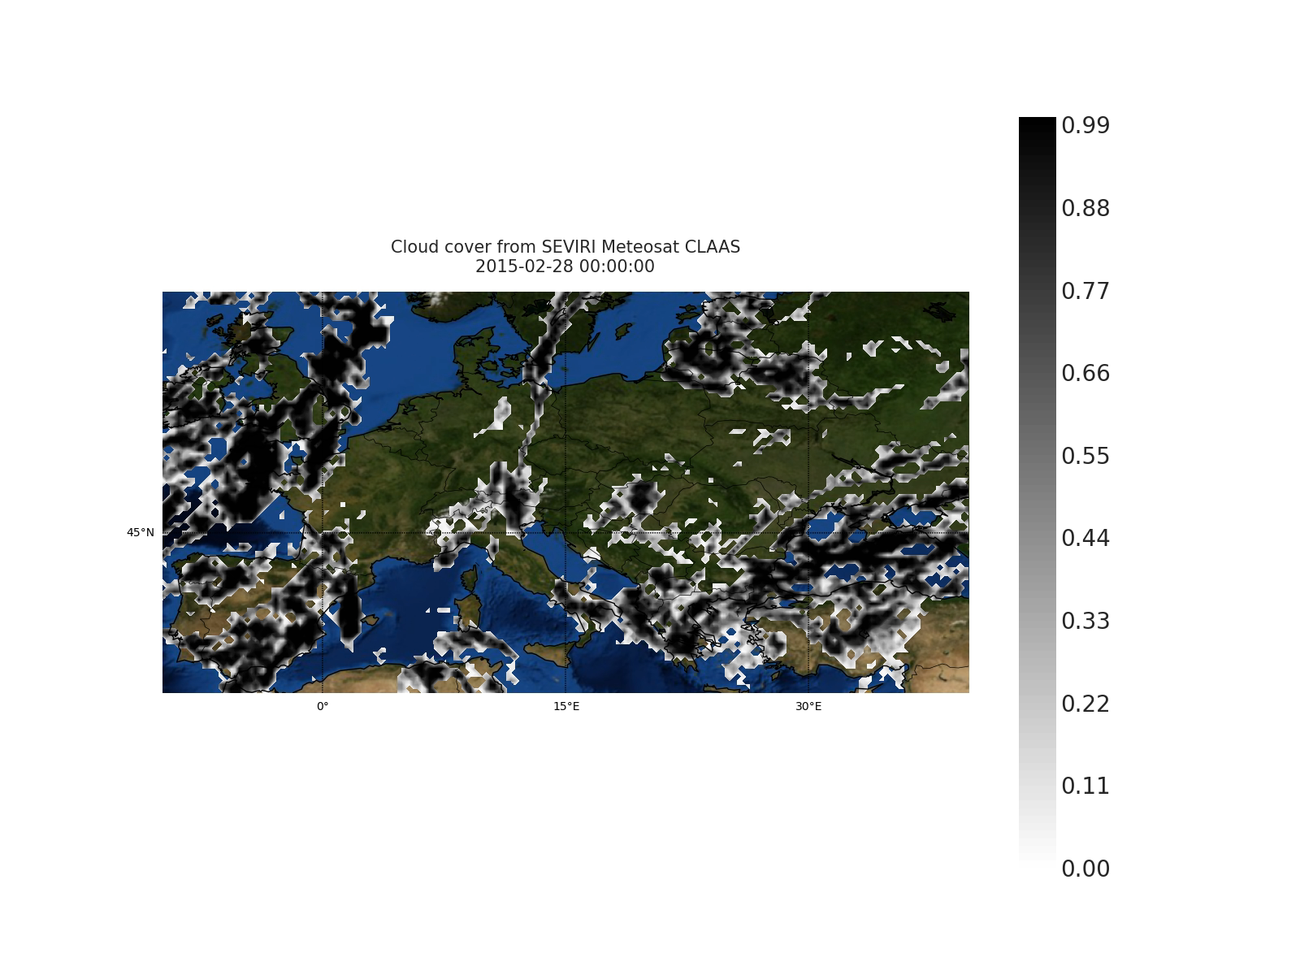
Cirrus data project
Result Meteosat
SEVIRI L2 -> L3
conversion

Slide 7
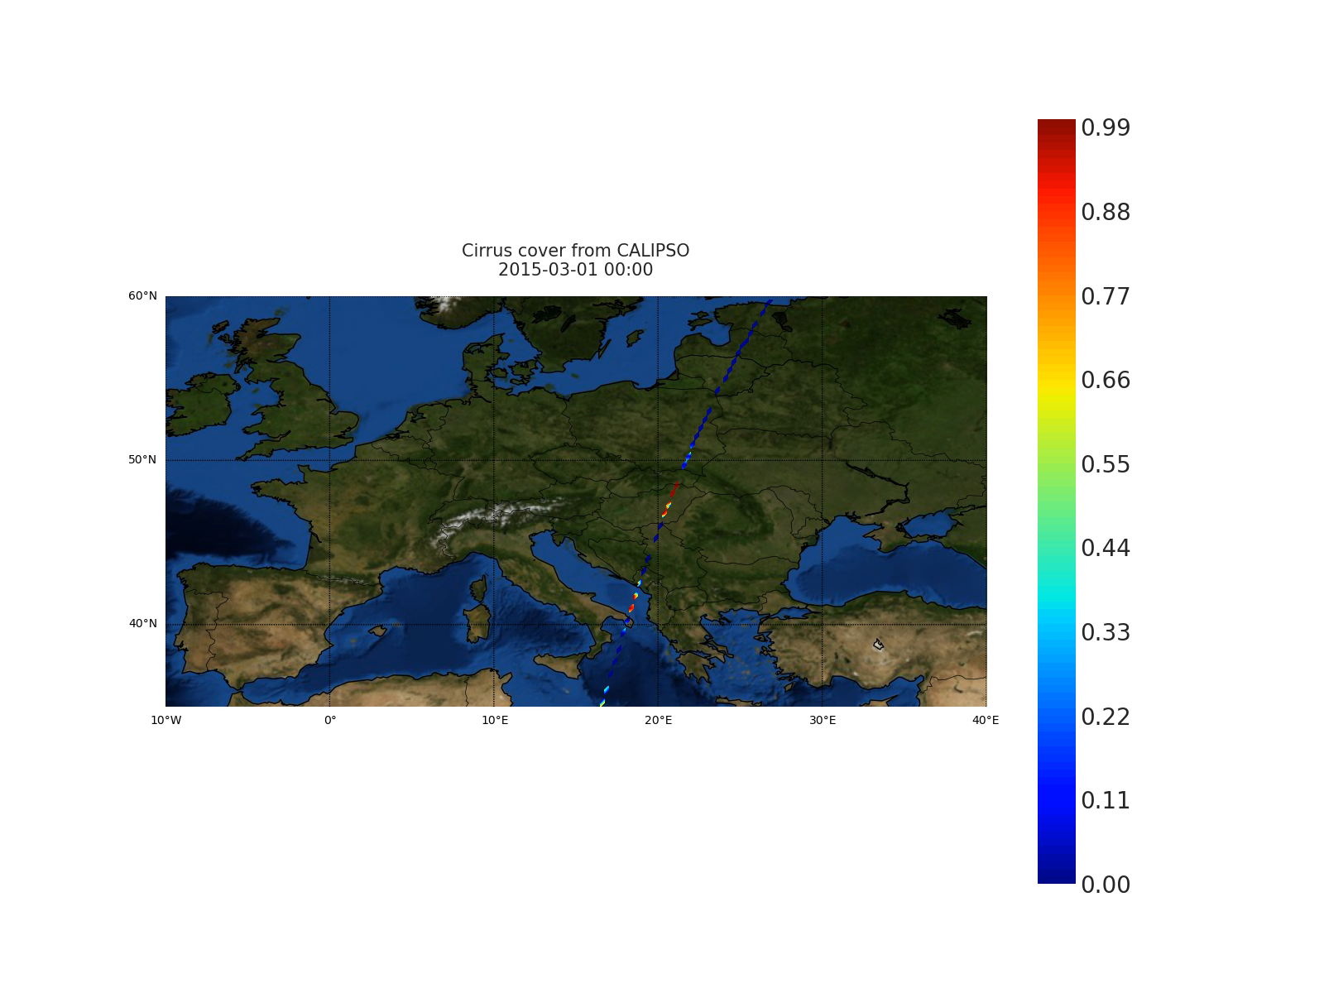
Cirrus data project
Result CALIPSO
L2 -> L3
conversion
Change from “satellite coordinates” to geographic coordinate system
Decrypt binary encrypted satellite data containing backscatter info (feature flags, confidence)

Slide 8
Cirrus data project
Current challenges
Store data in cloud
Learn how to work on GEMINI cluster
Retrieve rest of CALIPSO data (server connection fails)
Improve existing algorithms
Create model to handle confounding variables (logistic regression)

